Slide 1

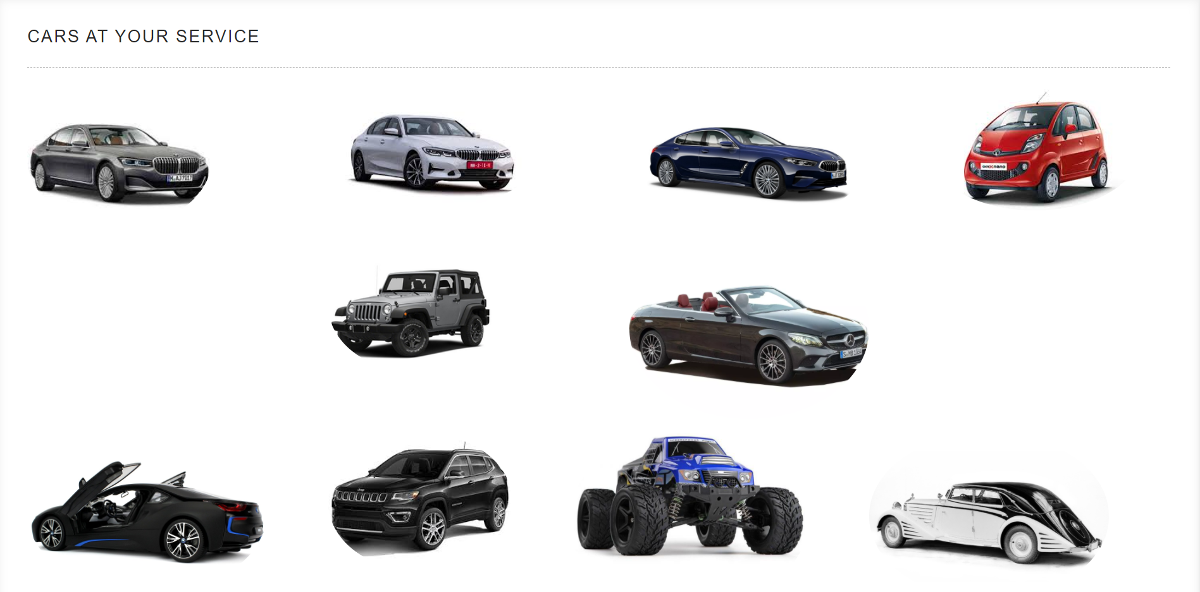
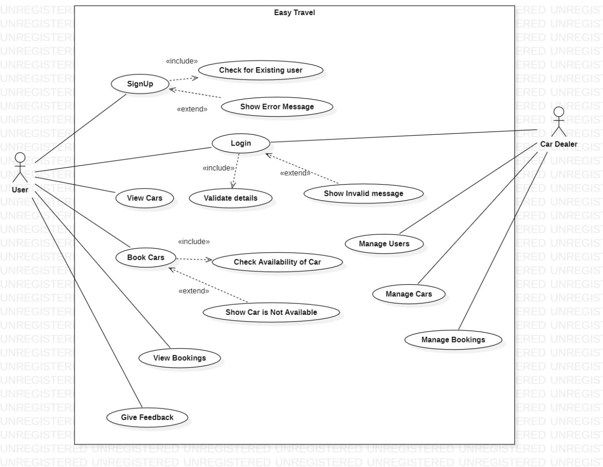
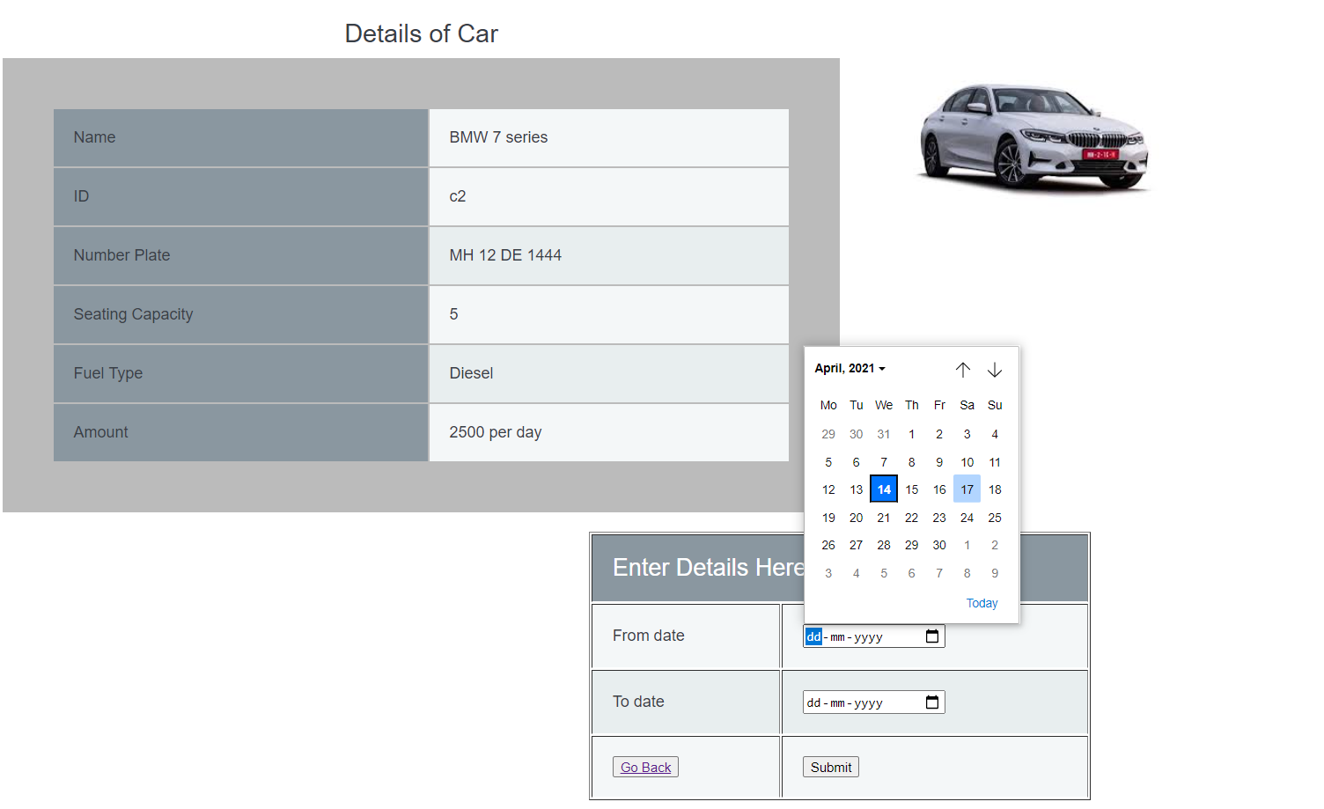
EasyTravel
(Batch 4)
190330228
190330079
190330184
Abstract
Modules
Car and bus travel agencies need an effective management platform for handling their respective transportation services. The existing system relies on manual data recording for management which is very tedious and time consuming, involving a lot of manpower and paper work. So, the current system need to be computerized, and if possible web-based.
The main idea of this project is to offer the best of car services to the clients in need. It has a fleet of cars ranging from normal budget cars to expensive luxury cars. The best thing about a web-based system such as this is that it offers online car hire for corporate houses. This makes the overall car service work easily accessible and reliable.
Admin: The admin can able to view all the user and their bookings. Also he could see all the available cars. He could easily view feedbacks of customers and solve the query.
Cars: This helps user to view all the list of cars.
Booking: The user can select the available cars and book then for a period of time.
My Bookings: This helps user to view his bookings.
Objective
The main objective of our project is to provide an option for the customer to choose his/her favourite car to travel instead of pouring so much money on taxis or to avoid overcrowded metro trains when he is out of town/. country
Our EasyTravel website allows the customer to book the rental online and could provide valuable feedback for improvement in services.
It has an easy to understand interface and as this system works online it allows anyone to book or rent a vehicle in a city without any time restriction
Conclusion
The web based car rental system has offered an advantage to both customers as well as Car Rental company to efficiently and effectively manage the business and Satisies customers need at the click of a button.
And considering present situations, online mode is very effective, comfy and also safe.
The proposed project is very flexible, so new features and modules can be added in the future as per user requirements.

